Slide 1
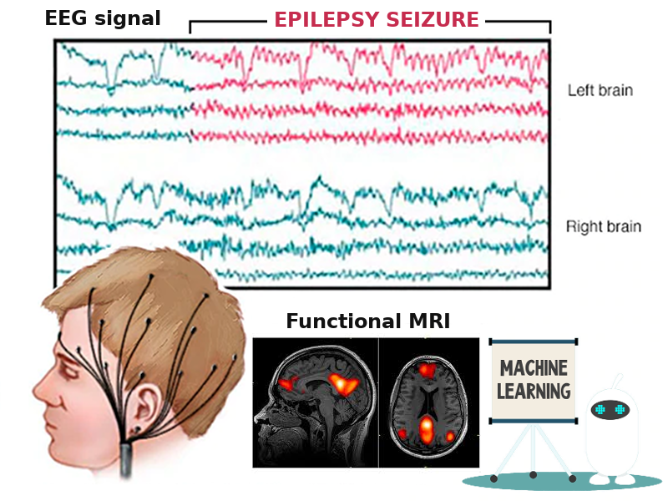
EEG and fMRI connectivity for predicting epilepsy surgery
Ellie Shamshiri | Marion Curdy
Margherita Carboni | Marjorie Metzger
Maria Rubega | Renoud-Grappin Rémi
Rafal Skiba | Wenli Tang

Slide 2
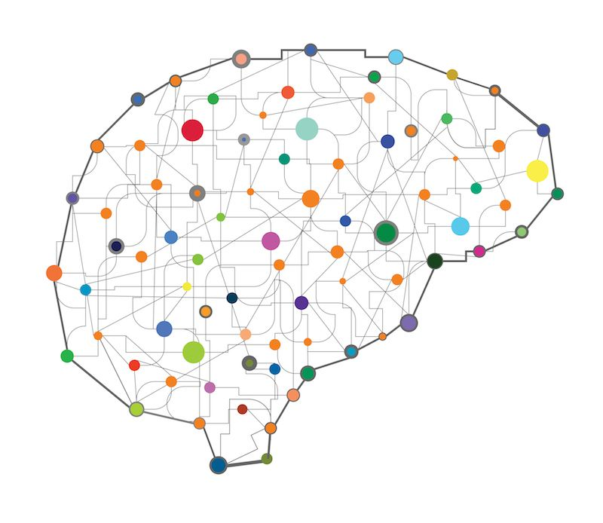
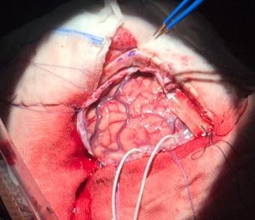
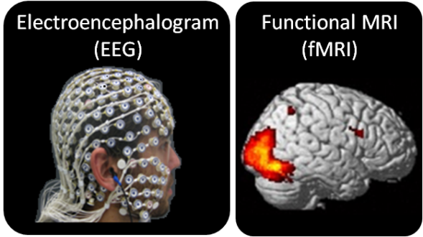
What is Epilepsy?
Epilepsy is a result of abnormal hyperexcitable and hypersynchronous neuronal activity.
resection
~25% of patients: drug-resistant
Surgery can be useful for treatment in drug-resistant epilepsy patients
Surgery
What do we need for surgery?
Localisation → where seizures are coming from
Predictions → for surgical outcome

Slide 3
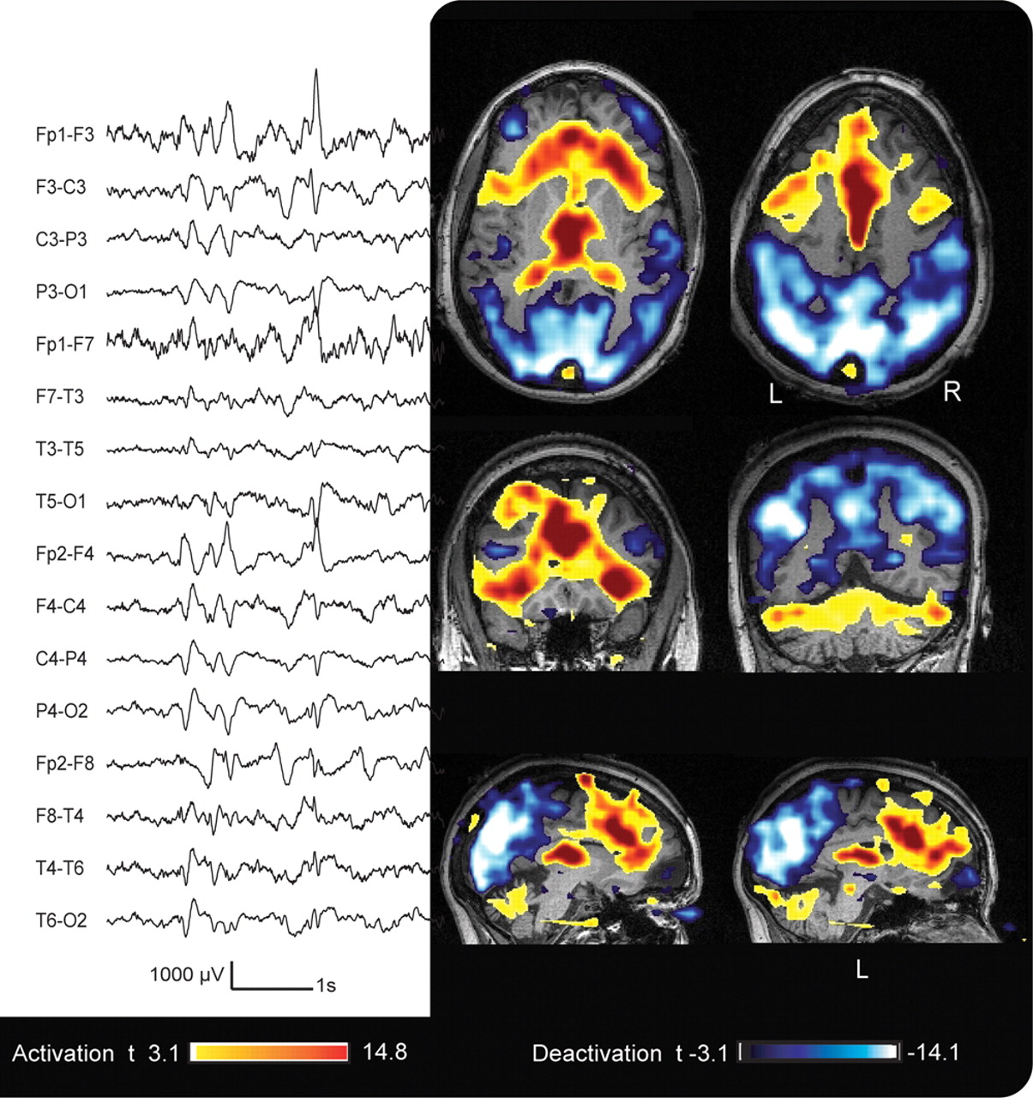
EEG & fMRI
EEGs are used as a very accurate diagnostic method due to its tremendous temporal resolution.
fMRI is a technique with large spatial resolution, which combined with EEGs provides a valuable information about the sources of seizures.

Slide 4
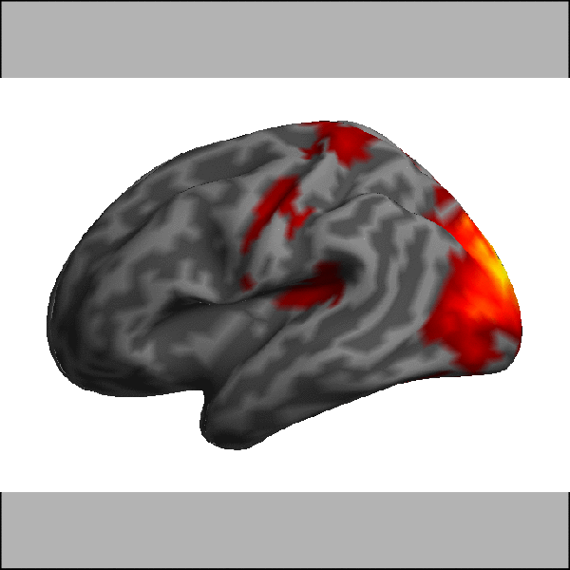
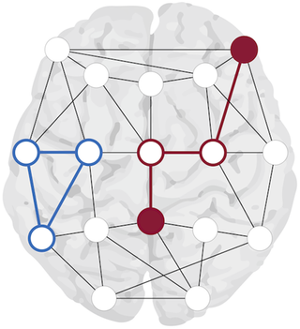
What is Connectivity?
Looking at different nodes in the brain to determine their relationship!

Slide 5
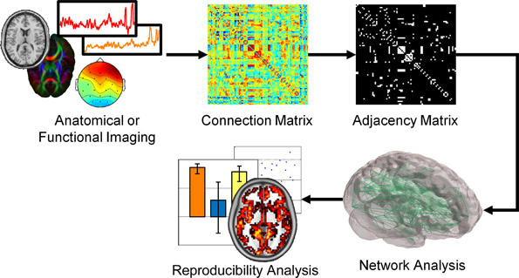
Anatomical and Functional networks

Slide 6
Data
fMRI
EEG
10 focal epilepsy patients (with pre & post operative data)
Functional connectivity
ROI x ROI correlation matrices
ROI timecourses
Both using the Lausanne parcellation via the Connectome Mapper (Daducci et al., 2012)
10 focal epilepsy patients
8 normal controls
Functional connectivity & power spectrum density
ROI x ROI x frequency x time matrices

Slide 7
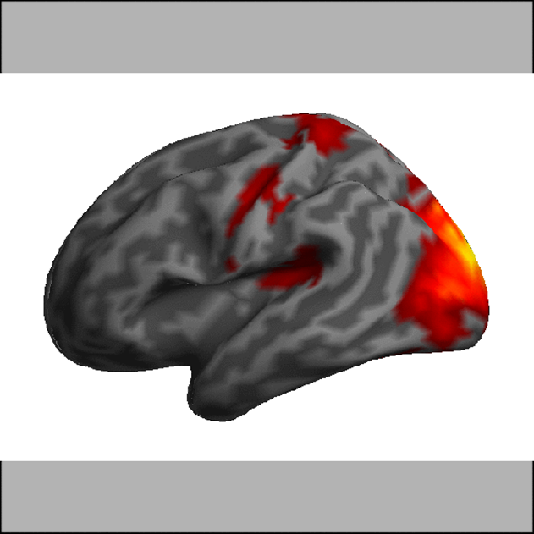
Goals
Manipulate and display brain connectivity data (resolved in space, time & frequency) of epilepsy patients and normal controls
Leverage data to predict surgery outcome (success vs failure) of patients suffering from drug-resistant epilepsy

Slide 8
THANK YOU!
MERCI!

